Slide 1
IO Management & Disk Scheduling

Slide 2
Introduction
I/O management and disk scheduling are essential components of a computer's operating system. I/O management controls the flow of data into and out of a data processing complex. Disk scheduling handles the organization and access of data on a disk.
I/O management involves:
Reading from or writing to devices, such as disks, network interfaces, or user input/output devices
Controlling the flow of data into and out of a data processing complex
Transferring information between computer memory and the outside world

Slide 3
Contt.
Disk scheduling involves:
Determining the order in which the read/write head of the disk moves to access data
Ensuring that only one I/O request can be served at a time by the disk controller
Handling multiple I/O requests that may arrive by different processes
Being written as a separate module of the operating system, allowing it to be replaced with a different algorithm if necessary

Slide 4
I/O Devices
I/O (input/output) devices are hardware that allows humans or other systems to communicate with a computer. I/O devices transfer data to and from a computer.
Examples of I/O devices include:
Input devices: Keyboards, mice, scanners, and hard disks
Output devices: Monitors, printers, and headphones

Slide 5
I/O Subsystems
The Input/Output (I/O) subsystem is a fundamental component of modern operating systems. It manages all input/output operations on a computer. The I/O subsystem provides various services that enable efficient and secure management of the I/O operations.
The I/O subsystem consists of:
The system bus, Disk controllers, Disks, Tape drives, Other I/O devices, Scheduling, Caching, Spooling, Device reservation, Error handling.
The I/O subsystem is also responsible for protecting itself from rogue programs and malicious users.
The I/O subsystem can increase the system's overall performance, distribute device access permissions evenly among all processes, and reduce average wait times, response times, and turnaround times for I/O to complete.

Slide 6
I/O Buffering
A buffer is a memory area that stores data being transferred between two devices or between a device and an application.
Uses of I/O Buffering :
Buffering is done to deal effectively with a speed mismatch between the producer and consumer of the data stream.
A buffer is produced in main memory to heap up the bytes received from modem.
After receiving the data in the buffer, the data get transferred to disk from buffer in a single operation.
This process of data transfer is not instantaneous, therefore the modem needs another buffer in order to store additional incoming data.
When the first buffer got filled, then it is requested to transfer the data to disk.
The modem then starts filling the additional incoming data in the second buffer while the data in the first buffer getting transferred to disk.
When both the buffers completed their tasks, then the modem switches back to the first buffer while the data from the second buffer get transferred to the disk.
The use of two buffers disintegrates the producer and the consumer of the data, thus minimizes the time requirements between them.
Buffering also provides variations for devices that have different data transfer sizes.

Slide 7
Contt.
Types of various I/O buffering techniques :
1. Single buffer : A buffer is provided by the operating system to the system portion of the main memory.
Block oriented device –
System buffer takes the input.
After taking the input, the block gets transferred to the user space by the process and then the process requests for another block.
Stream oriented device –
Line- at a time operation is used for scroll made terminals. User inputs one line at a time, with a carriage return signaling at the end of a line.

Slide 8
contt
2. Double buffer :
Block oriented –
There are two buffers in the system.
One buffer is used by the driver or controller to store data while waiting for it to be taken by higher level of the hierarchy.
Other buffer is used to store data from the lower level module.
Double buffering is also known as buffer swapping.
Stream oriented –
Line- at a time I/O, the user process need not be suspended for input or output, unless process runs ahead of the double buffer.
Byte- at a time operations, double buffer offers no advantage over a single buffer of twice the length.

Slide 9
Disk Storage and Disk Scheduling
A process needs two type of time, CPU time and IO time. For I/O, it requests the Operating system to access the disk.
The operating system must be fare enough to satisfy each request and at the same time, operating system must maintain the efficiency and speed of process execution.
The technique that operating system uses to determine the request which is to be satisfied next is called disk scheduling.

Slide 10
Contt..
Some important terms related to disk scheduling….
Seek Time
Seek time is the time taken in locating the disk arm to a specified track where the read/write request will be satisfied.
Rotational Latency
It is the time taken by the desired sector to rotate itself to the position from where it can access the R/W heads.
Transfer Time
It is the time taken to transfer the data.
Disk Access Time
Disk access time is given as,
Disk Access Time = Rotational Latency + Seek Time + Transfer Time
Disk Response Time
It is the average of time spent by each request waiting for the IO operation.

Slide 11
Purpose of Disk Scheduling
The main purpose of disk scheduling algorithm is to select a disk request from the queue of IO requests and decide the schedule when this request will be processed.
Goal of Disk Scheduling Algorithm
Fairness
High throughout
Minimal traveling head time

Slide 12
Disk Scheduling Algorithms
The list of various disks scheduling algorithm is given below. Each algorithm is carrying some advantages and disadvantages. The limitation of each algorithm leads to the evolution of a new algorithm.
FCFS scheduling algorithm
SSTF (shortest seek time first) algorithm
SCAN scheduling
C-SCAN scheduling
LOOK Scheduling
C-LOOK scheduling

Slide 13
Look Scheduling
It is like SCAN scheduling Algorithm to some extant except the difference that, in this scheduling algorithm, the arm of the disk stops moving inwards (or outwards) when no more request in that direction exists. This algorithm tries to overcome the overhead of SCAN algorithm which forces disk arm to move in one direction till the end regardless of knowing if any request exists in the direction or not.
Example
Consider the following disk request sequence for a disk with 100 tracks
98, 137, 122, 183, 14, 133, 65, 78
Head pointer starting at 54 and moving in left direction. Find the number of head movements in cylinders using LOOK scheduling.

Slide 14
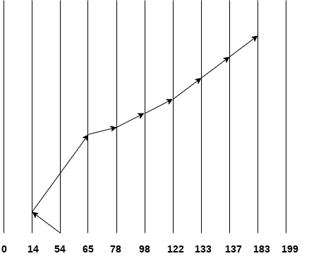
Contt..
Number of cylinders crossed = 40 + 51 + 13 + +20 + 24 + 11 + 4 + 46 = 209

Slide 15
C Look Scheduling
C Look Algorithm is similar to C-SCAN algorithm to some extent. In this algorithm, the arm of the disk moves outwards servicing requests until it reaches the highest request cylinder, then it jumps to the lowest request cylinder without servicing any request then it again start moving outwards servicing the remaining requests.
It is different from C SCAN algorithm in the sense that, C SCAN force the disk arm to move till the last cylinder regardless of knowing whether any request is to be serviced on that cylinder or not.
Example
Consider the following disk request sequence for a disk with 100 tracks
98, 137, 122, 183, 14, 133, 65, 78
Head pointer starting at 54 and moving in left direction. Find the number of head movements in cylinders using C LOOK scheduling.

Slide 16
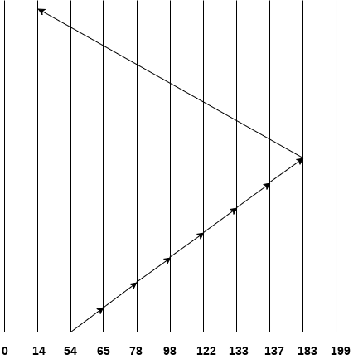
Contt…
Number of cylinders crossed = 11 + 13 + 20 + 24 + 11 + 4 + 46 + 169 = 298

Slide 17
FCFS scheduling algorithm
It is the simplest Disk Scheduling algorithm. It services the IO requests in the order in which they arrive. There is no starvation in this algorithm, every request is serviced.
Disadvantages
The scheme does not optimize the seek time.
The request may come from different processes therefore there is the possibility of inappropriate movement of the head.
Example
Consider the following disk request sequence for a disk with 100 tracks 45, 21, 67, 90, 4, 50, 89, 52, 61, 87, 25
Head pointer starting at 50 and moving in left direction. Find the number of head movements in cylinders using FCFS scheduling.

Slide 18
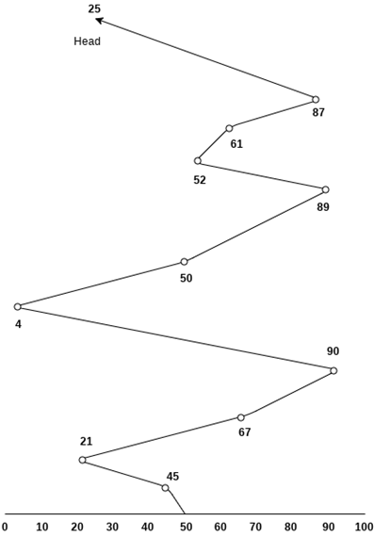
Contt..

Slide 19
Contt..
Number of cylinders moved by the head.
=(50-45)+(45-21)+(67-21)+(90-67)+(90-4)+(50-4)+(89-50)+(61- 52)+(87-61)+(87-25)
= 5 + 24 + 46 + 23 + 86 + 46 + 49 + 9 + 26 + 62
= 376

Slide 20
SSTF (shortest seek time first) algorithm
Shortest seek time first (SSTF) algorithm selects the disk I/O request which requires the least disk arm movement from its current position regardless of the direction. It reduces the total seek time as compared to FCFS.
It allows the head to move to the closest track in the service queue.
Disadvantages
It may cause starvation for some requests.
Switching direction on the frequent basis slows the working of algorithm.
It is not the most optimal algorithm.

Slide 21
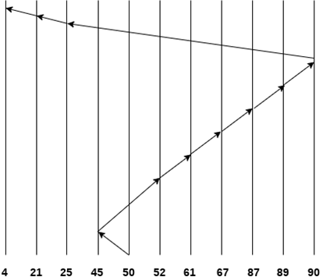
Contt.
Example
Consider the following disk request sequence for a disk with 100 tracks
45, 21, 67, 90, 4, 89, 52, 61, 87, 25
Head pointer starting at 50. Find the number of head movements in cylinders using SSTF scheduling.
Number of cylinders =
5 + 7 + 9 + 6 + 20 + 2 + 1 + 65 + 4 + 17 = 136

Slide 22
SCAN and C-SCAN algorithm
Scan Algorithm
It is also called as Elevator Algorithm. In this algorithm, the disk arm moves into a particular direction till the end, satisfying all the requests coming in its path,and then it turns backand moves in the reverse direction satisfying requests coming in its path.
It works in the way an elevator works, elevator moves in a direction completely till the last floor of that direction and then turns back.
Example
Consider the following disk request sequence for a disk with 100 tracks
98, 137, 122, 183, 14, 133, 65, 78
Head pointer starting at 54 and moving in left direction. Find the number of head movements in cylinders using SCAN scheduling.

Slide 23
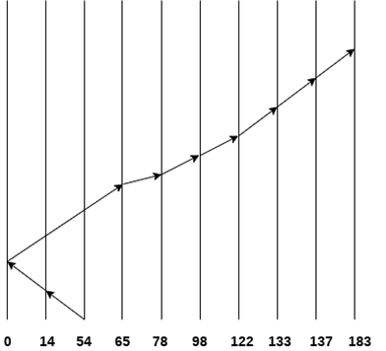
Contt...
Number of Cylinders = 40 + 14 + 65 + 13 + 20 + 24 + 11 + 4 + 46 = 237

Slide 24
C-SCAN algorithm
In C-SCAN algorithm, the arm of the disk moves in a particular direction servicing requests until it reaches the last cylinder, then it jumps to the last cylinder of the opposite direction without servicing any request then it turns back and start moving in that direction servicing the remaining requests.
Example
Consider the following disk request sequence for a disk with 100 tracks
98, 137, 122, 183, 14, 133, 65, 78
Head pointer starting at 54 and moving in left direction. Find the number of head movements in cylinders using C-SCAN scheduling.

Slide 25
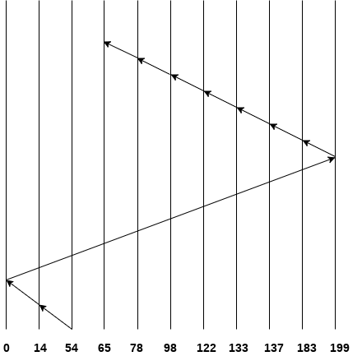
Contt..
No. of cylinders crossed = 40 + 14 + 199 + 16 + 46 + 4 + 11 + 24 + 20 + 13 = 387

Slide 26

File System
A file can be defined as a data structure which stores the sequence of records. Files are stored in a file system, which may exist on a disk or in the main memory. Files can be simple (plain text) or complex (specially-formatted).
The collection of files is known as Directory.
The collection of directories at the different levels, is known as File System.

Slide 27
Attributes of the File
1.Name
2.Identifier
3.Type
4.Location
5.Size
6.Protection
7.Time and Date

Slide 28
Operations on the File
Create operation:
Open operation:
Write operation:
Read operation:
Re-position or Seek operation:
Delete operation:
Close operation:
Rename operation:

Slide 29
File Access Methods
Let's look at various ways to access files stored in secondary memory.
Sequential Access
Most of the operating systems access the file sequentially. In other words, we can say that most of the files need to be accessed sequentially by the operating system.
In sequential access, the OS read the file word by word. A pointer is maintained which initially points to the base address of the file. If the user wants to read first word of the file then the pointer provides that word to the user and increases its value by 1 word. This process continues till the end of the file.
Modern word systems do provide the concept of direct access and indexed access but the most used method is sequential access due to the fact that most of the files such as text files, audio files, video files, etc need to be sequentially accessed.

Slide 30
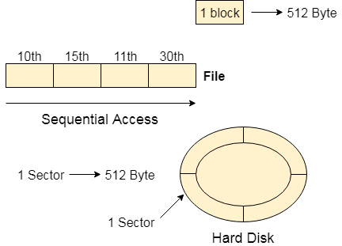
Contt..

Slide 31
Direct Access
The Direct Access is mostly required in the case of database systems. In most of the cases, we need filtered information from the database. The sequential access can be very slow and inefficient in such cases.
Suppose every block of the storage stores 4 records and we know that the record we needed is stored in 10th block. In that case, the sequential access will not be implemented because it will traverse all the blocks in order to access the needed record.
Direct access will give the required result despite of the fact that the operating system has to perform some complex tasks such as determining the desired block number. However, that is generally implemented in database applications.

Slide 32
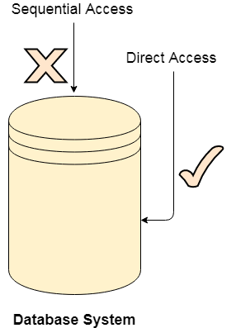
Contt..

Slide 33
Indexed Access
If a file can be sorted on any of the filed then an index can be assigned to a group of certain records. However, A particular record can be accessed by its index. The index is nothing but the address of a record in the file.
In index accessing, searching in a large database became very quick and easy but we need to have some extra space in the memory to store the index value.

Slide 34
Directory Structure in OS
What is a directory?
Directory can be defined as the listing of the related files on the disk. The directory may store some or the entire file attributes.
To get the benefit of different file systems on the different operating systems, A hard disk can be divided into the number of partitions of different sizes. The partitions are also called volumes or mini disks.
Each partition must have at least one directory in which, all the files of the partition can be listed. A directory entry is maintained for each file in the directory which stores all the information related to that file.
A directory can be viewed as a file which contains the Meta data of the bunch of files.

Slide 35
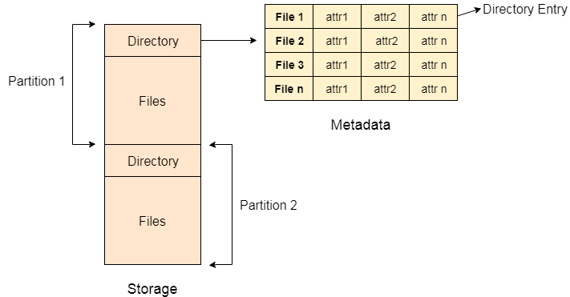
Cont..

Slide 36
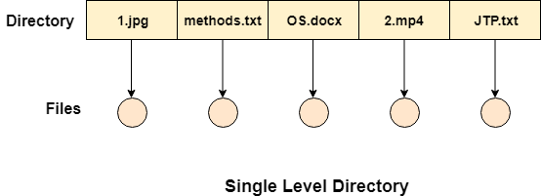
Single Level Directory
The simplest method is to have one big list of all the files on the disk. The entire system will contain only one directory which is supposed to mention all the files present in the file system. The directory contains one entry per each file present on the file system.

Slide 37
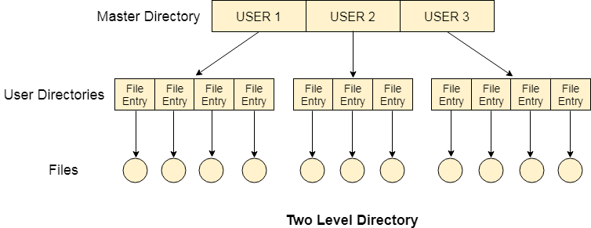
Two Level Directory
In two level directory systems, we can create a separate directory for each user. There is one master directory which contains separate directories dedicated to each user. For each user, there is a different directory present at the second level, containing group of user's file. The system doesn't let a user to enter in the other user's directory without permission.

Slide 38
Characteristics of two level directory system
Each files has a path name as /User-name/directory-name/
Different users can have the same file name.
Searching becomes more efficient as only one user's list needs to be traversed.
The same kind of files cannot be grouped into a single directory for a particular user.
Every Operating System maintains a variable as PWD which contains the present directory name (present user name) so that the searching can be done appropriately.

Slide 39
File System Implementation in Operating System
A file is a collection of related information. The file system resides on secondary storage and provides efficient and convenient access to the disk by allowing data to be stored, located, and retrieved.
File System Structure: The file system structure refers to how the files and directories are organized and stored on the physical storage device. This includes the layout of file systems data structures such as the directory structure, file allocation table, and inodes.
File Allocation: The file allocation mechanism determines how files are allocated on the storage device. This can include allocation techniques such as contiguous allocation, linked allocation, indexed allocation, or a combination of these techniques.
Data Retrieval: The file system implementation determines how the data is read from and written to the physical storage device. This includes strategies such as buffering and caching to optimize file I/O performance.
Security and Permissions: The file system implementation includes features for managing file security and permissions. This includes access control lists (ACLs), file permissions, and ownership management.
Recovery and Fault Tolerance: The file system implementation includes features for recovering from system failures and maintaining data integrity. This includes techniques such as journaling and file system snapshots.

Slide 40
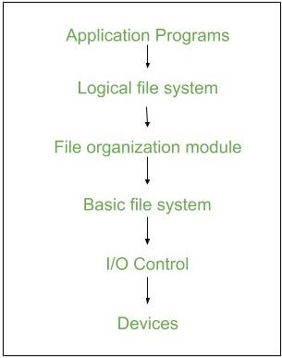
Contt..

Slide 41
File system Implementation Issues
Management of disc space: To prevent space wastage and to guarantee that files can always be stored in contiguous blocks, file systems must manage disc space effectively. Free space management, fragmentation prevention, and garbage collection are methods for managing disc space.
Checking for consistency and repairing errors: The consistency and error-free operation of files and directories must be guaranteed by file systems. Journaling, checksumming, and redundancy are methods for consistency checking and error recovery. File systems may need to perform recovery operations if errors happen in order to restore lost or damaged data.
Locking files and managing concurrency: To prevent conflicts and guarantee data integrity, file systems must control how many processes or users can access a file at once. File locking, semaphore, and other concurrency-controlling methods are available.
Performance optimization: File systems need to optimize performance by reducing file access times, increasing throughput, and minimizing system overhead. Caching, buffering, prefetching, and parallel processing are methods for improving performance.

Slide 42
Key Steps Involved In File System Implementation
File system implementation is a crucial component of an operating system, as it provides an interface between the user and the physical storage device. Here are the key steps involved in file system implementation:
Partitioning the storage device: The first step in file system implementation is to partition the physical storage device into one or more logical partitions. Each partition is formatted with a specific file system that defines the way files and directories are organized and stored.
File system structures: File system structures are the data structures used by the operating system to manage files and directories. Some of the key file system structures include the superblock, inode table, directory structure, and file allocation table.
Allocation of storage space: The file system must allocate storage space for each file and directory on the storage device. There are several methods for allocating storage space, including contiguous, linked, and indexed allocation.
File operations: The file system provides a set of operations that can be performed on files and directories, including create, delete, read, write, open, close, and seek. These operations are implemented using the file system structures and the storage allocation methods.
File system security: The file system must provide security mechanisms to protect files and directories from unauthorized access or modification. This can be done by setting file permissions, access control lists, or encryption.
File system maintenance: The file system must be maintained to ensure efficient and reliable operation. This includes tasks such as disk defragmentation, disk checking, and backup and recovery.

Slide 43
Protection and Security in Operating System
Protection and security requires that computer resources such as CPU, softwares, memory etc. are protected. This extends to the operating system as well as the data in the system. This can be done by ensuring integrity, confidentiality and availability in the operating system. The system must be protect against unauthorized access, viruses, worms etc.
Threats to Protection and Security
A threat is a program that is malicious in nature and leads to harmful effects for the system. Some of the common threats that occur in a system are −
Virus
Viruses are generally small snippets of code embedded in a system. They are very dangerous and can corrupt files, destroy data, crash systems etc. They can also spread further by replicating themselves as required.
Trojan Horse
A trojan horse can secretly access the login details of a system. Then a malicious user can use these to enter the system as a harmless being and wreak havoc.
Trap Door
A trap door is a security breach that may be present in a system without the knowledge of the users. It can be exploited to harm the data or files in a system by malicious people.
Worm
A worm can destroy a system by using its resources to extreme levels. It can generate multiple copies which claim all the resources and don't allow any other processes to access them. A worm can shut down a whole network in this way.
Denial of Service
These type of attacks do not allow the legitimate users to access a system. It overwhelms the system with requests so it is overwhelmed and cannot work properly for other user.

Slide 44
Protection and Security Methods
The different methods that may provide protect and security for different computer systems are −
Authentication
This deals with identifying each user in the system and making sure they are who they claim to be. The operating system makes sure that all the users are authenticated before they access the system. The different ways to make sure that the users are authentic are:
Username/ Password
User Key/ User Card
User Attribute Identification
One Time Password

